Slide 1
Predicting Kickstarter Success/Failure
By William Chirciu

Slide 2
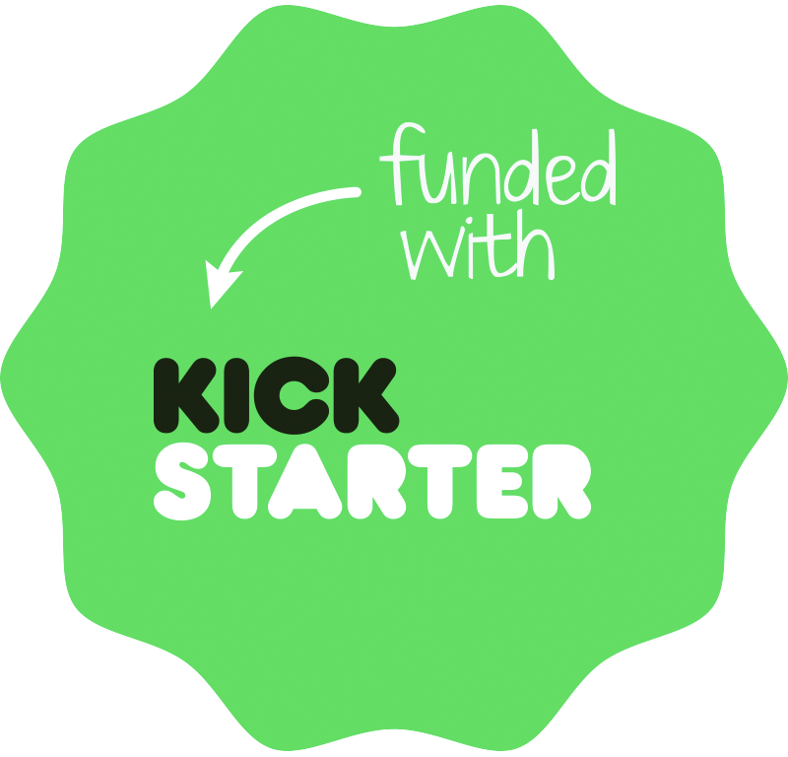
What is KICKSTARTER?
Funding Platform for creative projects
Financial Goal
Success/Failure
Reward Levels

Slide 3
Objectives
Problem: Only 37% of projects fully-funded
Look at probable factors that affect this
Generate Models to predict project success at launch

Slide 4
The Data
Obtained from Kaggle, sourced from Kickstarter repository
378k Kickstarter Projects from 2018
14 features
Target Variable = ‘State’ {Success, Failure, Suspended, Canceled, Live}
9 Qualitative Variables
6 Quantitative Variables

Slide 5
A Project Instance
ID: 1000002330
Name: The Songs of Adelaide & Abullah
Main Category: Publishing
Category: Poetry
Currency: GBP
Launch Date: 8/11/2015 12:12:00 PM
Deadline: 10/9/2015
Goal: 1000
Pledged: 0
Backers: 0
Country: GB
USD_pledged_real: 0
USD_goal_real: 1533.95
State: Failure

Slide 6
Preprocessing
Removed instances with missing data
Removed cancelled, suspended, live projects
Features:
ID/Name
Pledged/ Backers – dynamic features
Launch date/deadline ➔ Campaign Length in days
Kept Goal Amt in USD
332k instances with 7 features

Slide 7
Descriptive Statistics
 | Successful | Failure
# of Projects | 133,851 | 197,611
Average Goal | $9,536 | $63,189
Average Dur. | 32 days | 35 days
Average Pledged | $17,367 | $1,133
# of Backers | 264 | 16

Slide 8
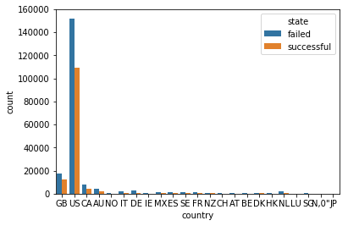
Success/Fail Rate by Country
state | failed | successful
country
HK | 0.547170 | 0.452830
US | 0.581807 | 0.418193
GB | 0.590310 | 0.409690
SG | 0.607930 | 0.392070
DK | 0.611231 | 0.388769
FR | 0.639683 | 0.360317
NZ | 0.648352 | 0.351648
SE | 0.662691 | 0.337309
CA | 0.665804 | 0.334196
LU | 0.666667 | 0.333333
JP | 0.695652 | 0.304348
AU | 0.696191 | 0.303809
IE | 0.696925 | 0.303075
BE | 0.709369 | 0.290631
CH | 0.713190 | 0.286810
MX | 0.719348 | 0.280652
NO | 0.721649 | 0.278351
DE | 0.727299 | 0.272701
ES | 0.737320 | 0.262680
NL | 0.744090 | 0.255910
AT | 0.779381 | 0.220619
IT | 0.814690 | 0.185310

Slide 9
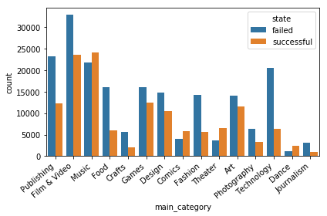
Success/Fail Rate by Category
state | failed | successful
main_category
Dance | 0.345648 | 0.654352
Theater | 0.362039 | 0.637961
Comics | 0.408585 | 0.591415
Music | 0.473394 | 0.526606
Art | 0.551110 | 0.448890
Games | 0.561095 | 0.438905
Film & Video | 0.582094 | 0.417906
Design | 0.584056 | 0.415944
Publishing | 0.652983 | 0.347017
Photography | 0.658892 | 0.341108
Fashion | 0.717168 | 0.282832
Food | 0.724086 | 0.275914
Crafts | 0.729470 | 0.270530
Journalism | 0.756086 | 0.243914
Technology | 0.762144 | 0.237856

Slide 10
Predictive Models
Decision Tree
Random Forest [RandomForestClassifier()]
Gradient Boost [GradientBoostingClassifier()]
Ada Boost [AdaBoostClassifier()]
Neural Network [MLPClassifier()]

Slide 11
Feature Selection: Chi-Squared
Rank | Feature | Score
1 | Usd_goal_real | 5535453576
2 | Campaign_len_days | 21405
3 | Category | 9620
4 | Country | 2012
5 | Currency | 1569
6 | Main Category | 708

Slide 12
Performance Metrics and Evaluation
Accuracy: % of correctly predicted instances
AUC: measure of separability
# of Features
Run Times
5-fold Cross-Validation

Slide 13
Decision Tree
Model | Accuracy | AUC | # Feat.
1 | 0.67 | 0.71 | 6
2 | 0.66 | 0.70 | 5
3 | 0.66 | 0.70 | 4
4 | 0.66 | 0.70 | 3
5 ( - cat) | 0.64 | 0.67 | 2
6 | 0.61 | 0.63 | 1
Criterion: Gini
Splitter: Best
Run Times ➔ 5 – 7 seconds

Slide 14
Random Forest
Model | Accuracy | AUC | # Feat.
1 | 0.68 | 0.73 | 6
2 | 0.67 | 0.72 | 5
3 | 0.67 | 0.72 | 4
4 | 0.67 | 0.72 | 3
5 (-cat) | 0.64 | 0.67 | 2
6 | 0.61 | 0.63 | 1
# of Estimators = 10 – 100 (10)
min_samples_leaf = 50
Run Times ➔ 21 – 84 seconds

Slide 15
Gradient Boosting
Model | Accuracy | AUC | # Feat.
1 | 0.69 | 0.74 | 6
2 | 0.68 | 0.73 | 5
3 | 0.68 | 0.73 | 4
4 | 0.68 | 0.73 | 3
5 (-cat) | 0.64 | 0.67 | 2
6 | 0.61 | 0.64 | 1
# of Estimators = 10 – 100 (50)
Learning Rate = 0.1
min_samples_split = ~1% of instances
Run Times ➔ 50 – 184 seconds

Slide 16
Ada Boost
Model | Accuracy | AUC | # Feat.
1 | 0.64 | 0.68 | 6
2 | 0.64 | 0.68 | 5
3 | 0.64 | 0.68 | 4
4 | 0.64 | 0.67 | 3
5 (-cat) | 0.63 | 0.66 | 2
6 | 0.61 | 0.63 | 1
# of Estimators = 10 – 1000 (100)
Learning Rate = 0.1
Run Times ➔ 120 – 186 seconds

Slide 17
Model | Accuracy | AUC
Decision Tree | 65.1% | 64.7%
Random Forest | 66.7% | 66.4%
Gradient Boost | 66.9% | 66.4%
Ada Boost | 61.8% | 62.7%
Neural Network | 63.6% | 63.1%

Slide 18
Neural Network
Model | Accuracy | AUC | # Feat.
1 | 0.66 | 0.69 | 6
2 | 0.64 | 0.68 | 5
3 | 0.65 | 0.68 | 4
4 | 0.64 | 0.67 | 3
5 (-cat) | 0.63 | 0.66 | 2
6 | 0.61 | 0.63 | 1
Activation : Rectified Linear Unit (relu)
Solver: Adam
Hidden Layers: (10,10)
Run Times: 97 – 357 seconds

Slide 19
Picking the Optimal Model
Best run times ➔ Decision Tree
Highest Scores ➔ Gradient Boost
Jack of all Trades ➔ Random Forest
Ada Boost and Neural Network underperforming
Performance > features > run times

Slide 20
Conclusion
Best Model: Gradient Boosting with 3 features - 68% accuracy
Goal amount, category, campaign length most important features
Slight improvement using Ensemble Methods

Slide 21
Limitations
CPU
SVMs
More Static Features:
# of Reward Tiers
Project Description
Deeper Search of Parameter Space

Slide 22
Future Work
Third Party Kickstarter Application
success/fail chance based on user input
Recommendations
Implement dynamic features

